Slide 1
EMPLOYEE RETENTION
Group 3

Slide 2
GROUP MEMBERS
Pinki Rajeesh
Asrith
JIJO
Saddam
Yuvaraj Naik

Slide 3

HR Analytics – Employee Retention
Departments – 6
Job Role’s offered - 10
Total no. of Employees – 50,000
Attrition Rate- 50.21%
Male Employees – 25,059
Female Employees – 24,941
Active Employees – 24,895

Slide 4
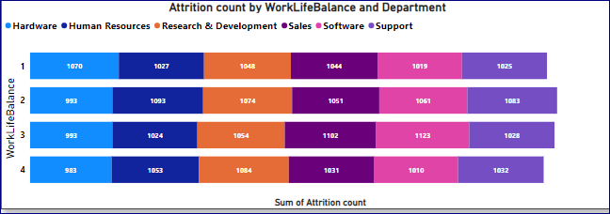
Department Wise Attrition rate
Consistent attrition rate across all department.
Research & Development department have high attrition rate
The data indicates that certain departments in the company have a high attrition rate and low work-life balance.

Slide 5
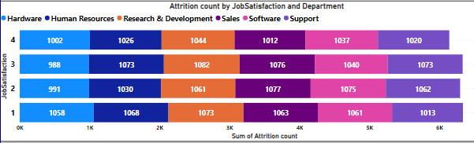
One of the reason for increasing Attrition rate is job satisfaction
Low job satisfaction, it potentially influencing attrition Rate.
CONCLUSION
The company can implement measures to improve employee satisfaction and retention, such as providing opportunities for professional growth and development, flexible work hours. Company have a high attrition rate and low work-life balance issues can be achieved by evaluating the reasons behind the low work-life balance and implementing measures to improve it.

Slide 6

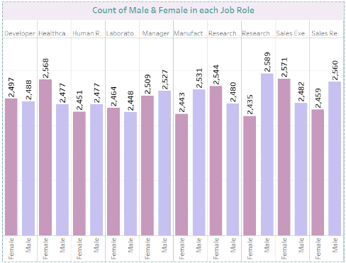
Average Hourly rate of Male Research Scientist
Observation
Average Hourly rate for all depart is almost similar.
For male research scientist is 114.45
Sales Representative have lowest Hourly rate
Male have lowest hourly rate compare to women
Less the hourly rate high the attrition rate.
Conclusion
If we want to decrease the attrition rate we have
to improve hourly rate for all the department.
In each department if the attrition rate is high
and hourly rate is also high then improve the others aspects

Slide 7
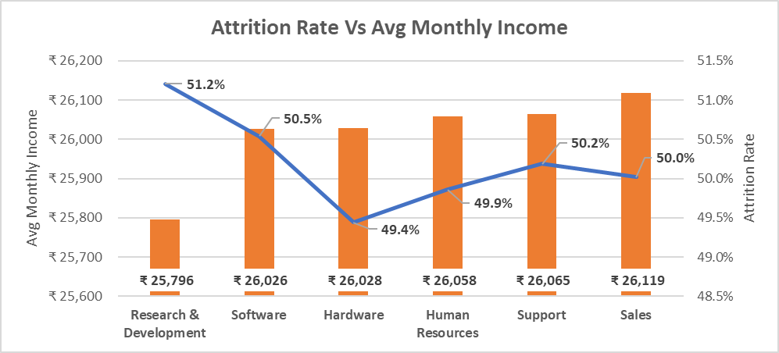
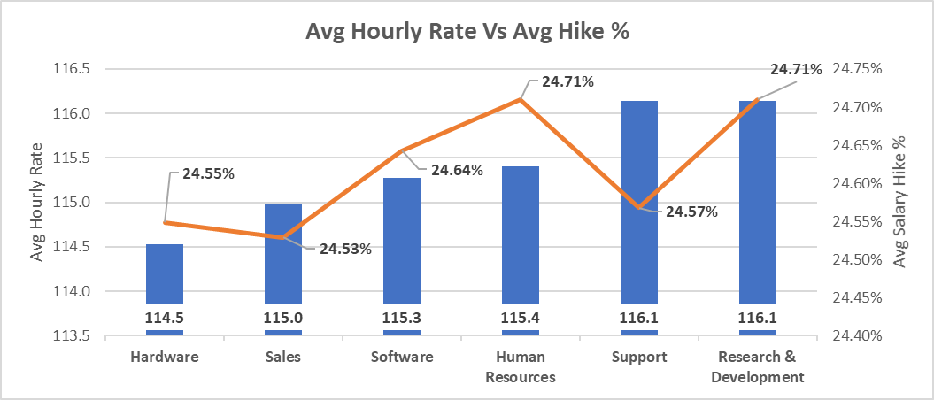
Attrition Rate Vs Monthly Income
Observations :
Attrition Rate shows minor variations, around 50% across all the departments but there is no clear correlation when compared with Avg monthly income.
Because departments having higher avg salary had significantly higher attrition rate in some cases.
So we compared Avg hourly rate and Avg salary hike % .
Recommendations :
If we want to decrease the attrition rate we need to consider increasing there salary’s.
We need to increase the salary based on the Hourly rate for each department.
Focus on salary analysis for competitiveness
Exit interviews to know the reasons of quitting the organization
Retention programs like mentorship and Career development will help to reduce attrition rate.

Slide 8
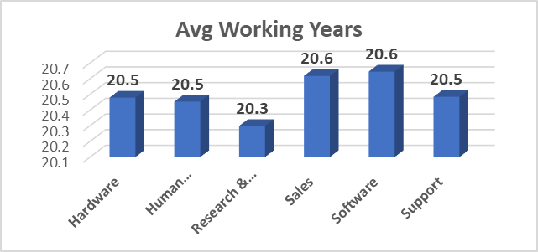
Average working years for each Department
Observations :
Due to rapid growth in salary and rapidly evolving technology younger generation prefer to spend more years in software.
R &D employees spend lesser years as very less people develop ability to research and develop new technologies
Working in Sales employees receive additional commissions for their hard work. Their job involves interacting with their clients.
Conclusion:
The Sales & Software department boasts the highest average working years at 20.6 years, indicating a strong sense of stability and experience within the team.

Slide 9
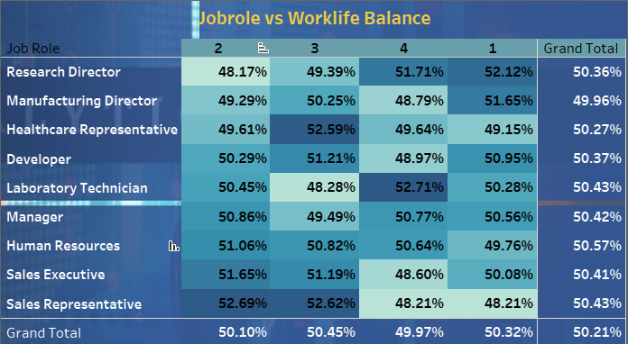
Job Role vs work-life Balance
Observation:
-It has been observed that attrition rate of all the job role and work-life balance is approximately same.
-Human Resources has highest(50.57%) attrition rate and Manufacturing Director has lowest (49.96%).
- Laboratory Technician of work life balance 4 and Sales Representatives of work life balance 2 & 3 has highest attrition rate.
Conclusion:
In Conclusion , the pursuit of a balanced life is not compromised but a strategic investment. It is a recognition that personal growth, relationships and rejuvenation are foundational to excelling in any job role.

Slide 10
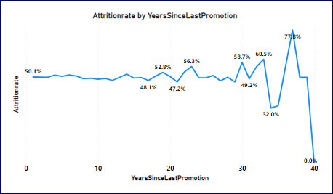
Attrition rate vs years since last promotions
Observation:
- According to the observations we can see that attrition rates vary within range around 32.0%-77.8%.
-There is not clear linear or consistent trend in attrition rate as year since last promotion increase.
-It might be worth considering other factor that could influence attrition such as job role, department, Monthly income stats, work life balance overall Job Market conditions.
Conclusion:
Even though there is no clear relation between attrition and year since last promotion and there may be other factor that could be influencing attrition. We can conclude that employees getting promoted early are not leaving the company, so company should promote employees within 10 years periods.

Slide 11
Thank You !

